Slide 1

Advanced Financial Fraud Detection System
Presented by
Mahmud Hasan Khan
(ID: 2025-1-83-005),
Senior Data Scientist,
XYZ Digital bank.

Slide 2






Agenda
The Data Story
Methodology
Results & Performance
Strategic Recommendation
Q & A

Slide 3

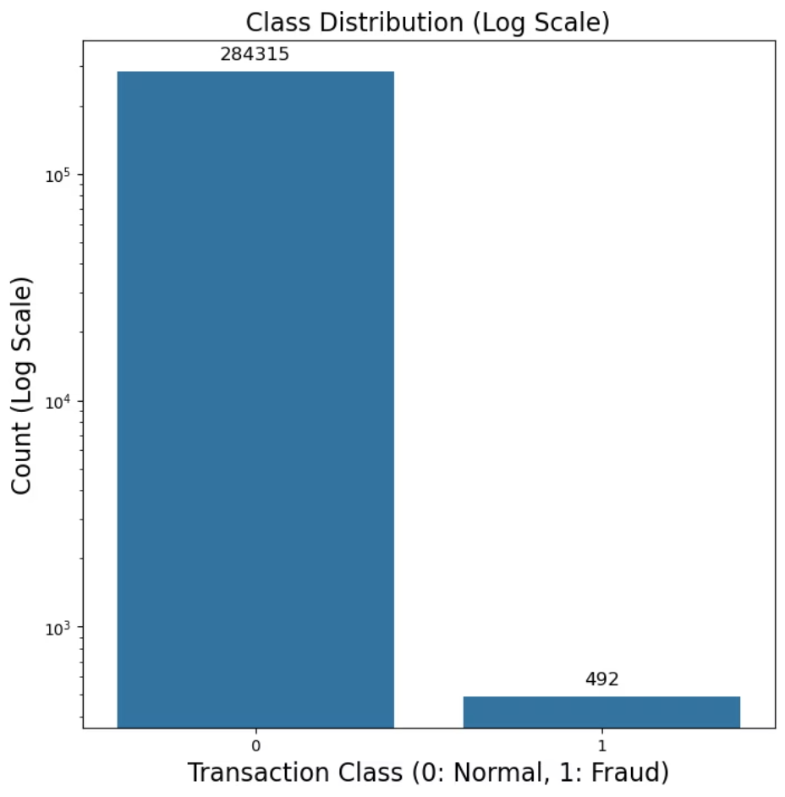
The Data Story: The Imbalance Challenge
Needle in a Haystack
Contained 284,807 transactions.
Only 492 were fraudulent.
Extreme imbalance (around 0.17% fraud) makes standard detection methods ineffective.

Slide 4
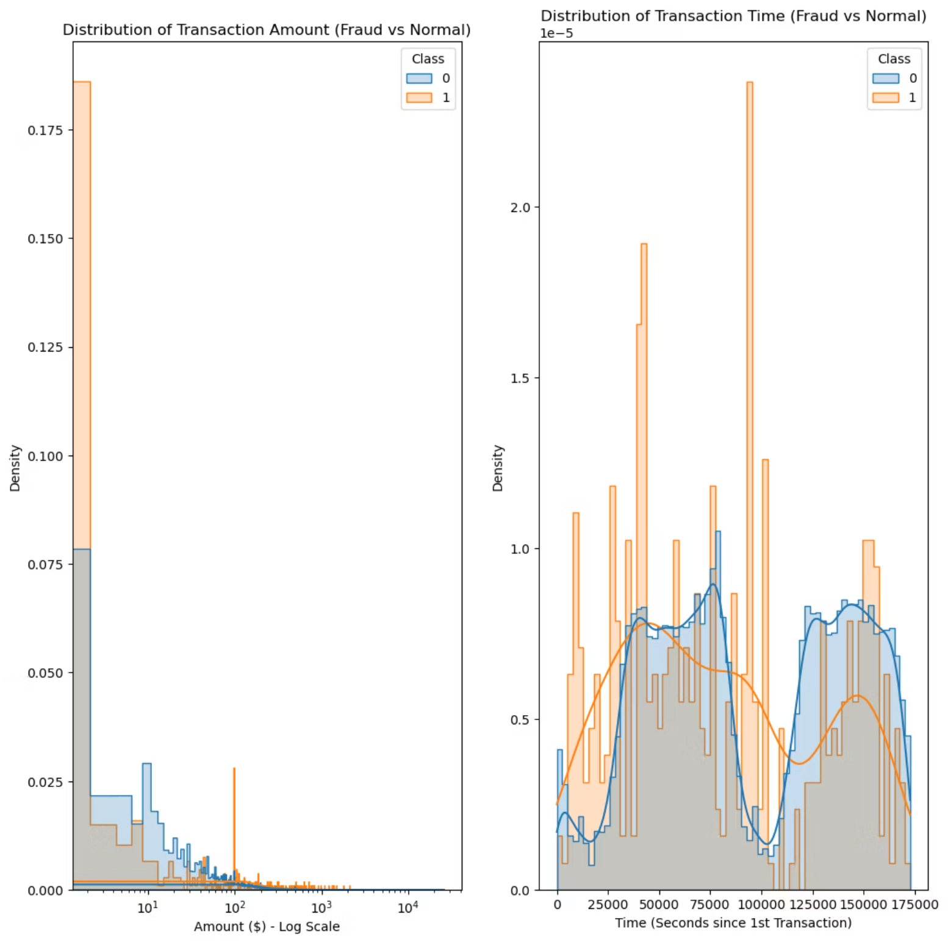
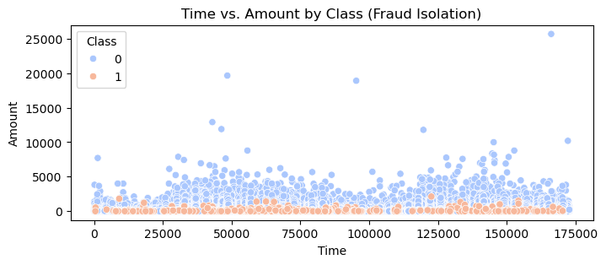
The Data Story: Spending Patterns
Fraud vs. Normal Transactions
Fraud: Predominantly low-value transactions. Fraudsters test cards with small amounts to avoid triggering alerts.
Normal: Spans the full range of low to high amounts, reflecting diverse consumer behavior.
Takeaway: We cannot rely on high transaction amounts alone to flag fraud. Our model must identify complex, hidden patterns within the data, moving beyond simple thresholds.

Slide 5

Methodology: Building a Robust System
Data Preparation
Solving the Imbalance
Scaling: Applied Robust Scaling to "Time" and "Amount" to prevent outliers from skewing results.
Fraud represents only 0.17% of data, making it hard for models to learn effectively.
Splitting: Divided data into 70% Training (to teach the model) and 30% Testing (to evaluate performance on unseen data).
Solution: Implemented SMOTE (Synthetic Minority Over-sampling Technique) to generate synthetic fraud examples, balancing the training set for better learning of crime patterns.
Dual-Model Comparison
Unsupervised ("The Watchdog"): Isolation Forest – Scans for anomalies without prior knowledge of fraud.
Supervised ("The Detective"): XGBoost – Uses historical data to classify transactions as "Normal" or "Fraud" with high precision.

Slide 6
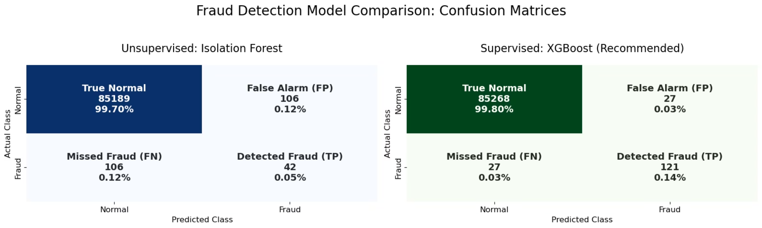
Results & Performance: Model Testing
Both models were rigorously tested on 85,443 live transactions containing 148 actual fraud cases.
This real-world scenario evaluation provides a clear picture of each model's effectiveness in identifying fraudulent activities while minimizing false positives.

Slide 7

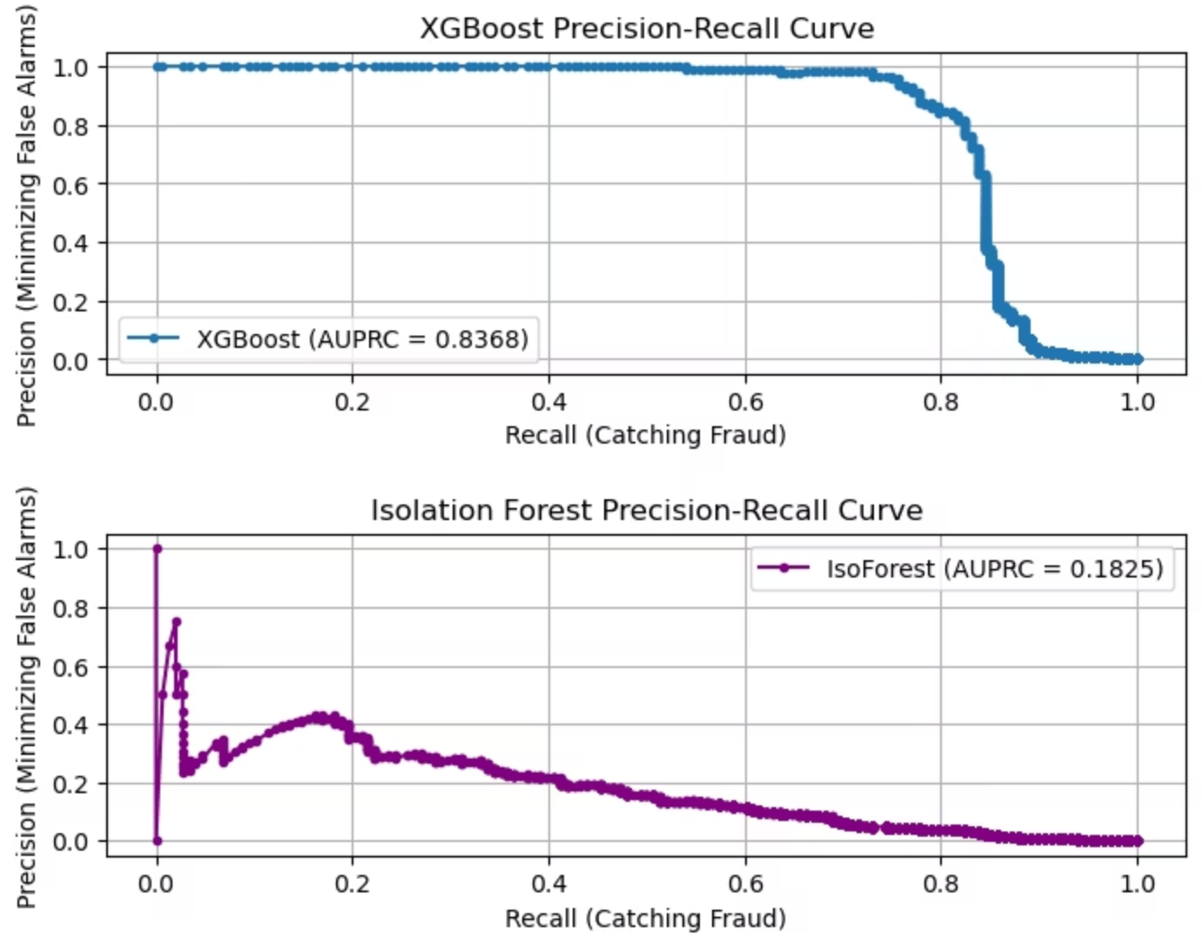
Results & Performance: Visualizing Outcomes
The visual representation above highlights the distinct performance characteristics of the Isolation Forest (Unsupervised) and XGBoost (Supervised) models. It clearly illustrates how each model approaches fraud detection and its respective strengths and weaknesses in a live environment.

Slide 8
Results & Performance: Key Metrics
Model
Precision
Recall
F1-Score
AUPRC
Isolation Forest (Unsupervised)
0.2838
0.2838
0.2838
0.1825
XGBoost (Supervised)
0.8176
0.8176
0.8176
0.8368
These metrics demonstrate the superior performance of the XGBoost model across all key indicators, particularly in AUPRC, which is crucial for imbalanced datasets like fraud detection.

Slide 9

Results & Performance: Comparative Analysis
Isolation Forest
As an unsupervised model, it identifies anomalies without prior fraud labels. While useful for initial detection, its precision and recall are lower, leading to more false positives and missed fraud cases.
XGBoost
Leveraging supervised learning, XGBoost demonstrates significantly higher precision, recall, F1-score, and AUPRC. This indicates its strong ability to accurately identify fraud while minimizing false alarms, crucial for financial applications.

Slide 10


Strategic Recommendation: Deploy XGBoost
Verdict: Deploying the Supervised XGBoost Model will provide the optimal balance between Risk Management and Customer Satisfaction.
Money Saved (Recall): By catching 121 out of 148 fraud cases, we stop the majority of financial leakage before it happens.
Customer Experience (Precision): The model generated only ~26 false alarms in over 85,000 transactions. This minimizes legitimate customer frustration and churn.

Slide 11


Question and Answer Session

Slide 12
Thank You

